Slide 1
Micron HFW treatment - Lab Jar Testing using CaCl2

Slide 2
Objective of the Base Case Study
To evaluate the effectiveness of Fluoride precipitation using calcium chloride (CaCl2) for fluoride containing wastewater

Slide 3
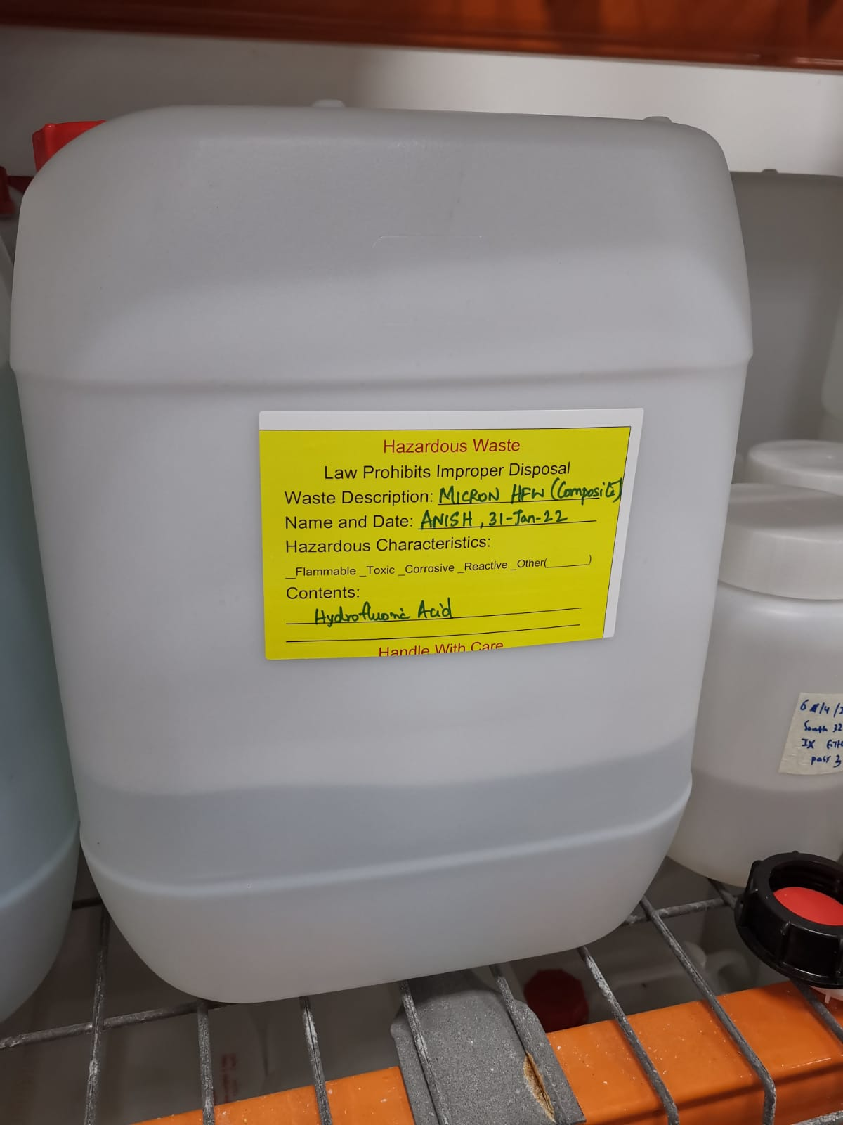
Composite feed collected on 31-Jan-2022 Jar testing using CaCl2

Slide 4
Base case experiment
3 beakers of 250 ml each of HFW feedwater is considered
Once dosed, allow rapid mixing for 30s, & followed by Slow mixing for 45 min
Dose 1 mg/L of SNF polymer (anionic) for each jars and further slower mix (60 rpm) for 45 min
Stop mixing and leave the solids to settle over 60 min, allow sludge settling
All supernatant was collected for analysis
Case 1 Dosage | Case 2 Dosage | Case 3 Dosage
pH adjusted to 8 + 3500 mg/L CaCl2 | pH adjusted to 8 + 4000 mg/L CaCl2 | pH adjusted to 8 + 4500 mg/L CaCl2

Slide 5
Jar testing – Coagulation step
EC (µS/cm) |  |  |  | TDS (ppm) |  |  | pH
Time elapsed (min) | Jar 1 | Jar 2 | Jar 3 | Jar 1 | Jar 2 | Jar 3 | Jar 1 | Jar 2 | Jar 3
Added 355 µL NaOH
0 | - | - | - | - | - | - | 8.12 | 8.11 | 8.07
Added CaCl2
2 | 7851 | 8609 | 9416 | 4237 | 4680 | 5150 | 7.03 | 6.95 | 6.84
20 | 7839 | 8606 | 9415 | 4230 | 4677 | 5150 | 6.78 | 6.71 | 6.63
Added 5 µL NaOH
35 | 7845 | 8608 | 9418 | 4233 | 4679 | 5152 | 7.43 | 7.33 | 7.28
49 | 7842 | 8610 | 9422 | 4231 | 4680 | 5153 | 7.23 | 7.14 | 7.11

Slide 6
Jar testing – Flocculation step
EC (µS/cm) |  |  |  | TDS (ppm) |  |  | pH
Time elapsed (min) | Jar 1 | Jar 2 | Jar 3 | Jar 1 | Jar 2 | Jar 3 | Jar 1 | Jar 2 | Jar 3
Added 1 mg/L Anionic polymer
0 | - | - | - | - | - | - | 6.96 | 6.92 | 6.90
Added 2 µL NaOH
28 | - | - | - | - | - | - | 7.41 | 7.32 | 7.29
Supernatant quality (measured after sludge settling)
EC (µS/cm) |  |  | TDS (ppm) |  |  | pH
Jar 1 | Jar 2 | Jar 3 | Jar 1 | Jar 2 | Jar 3 | Jar 1 | Jar 2 | Jar 3
7855 | 8625 | 9436 | 4239 | 4689 | 5163 | 7.02 | 7.00 | 6.99

Slide 7
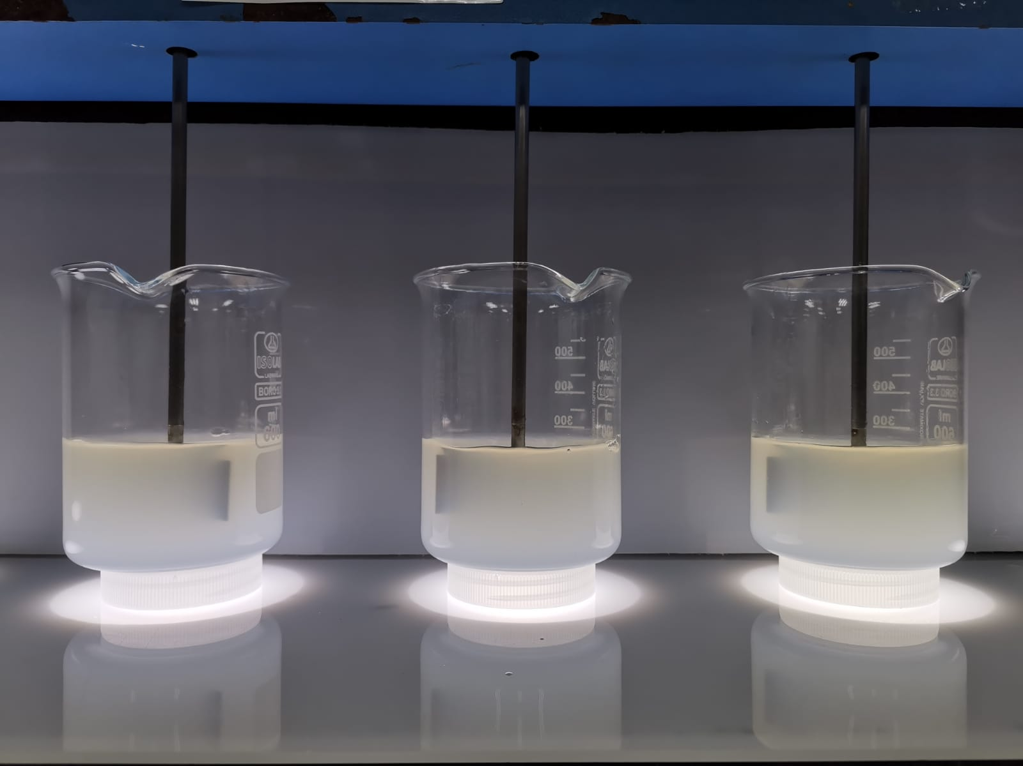
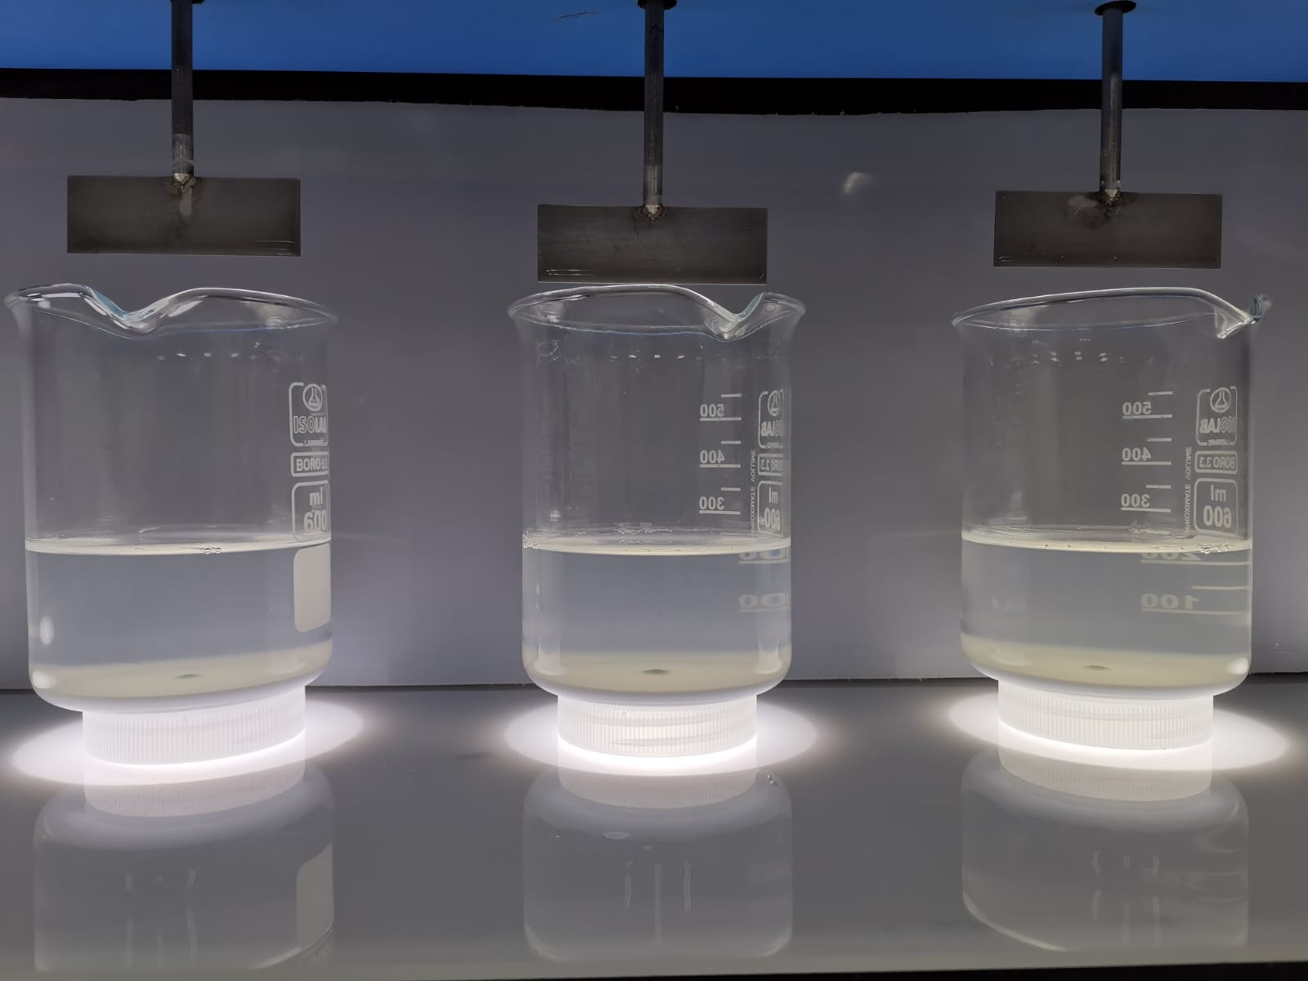
Jar Testing – Addition of chemicals
Addition of chemicals into different jars (left to right: case 1, 2 and 3)
Sludge settling (left to right: case 1, 2 and 3)

Slide 8
Base case experiment 1- Jar testing treated water analysis
Parameters | Units | Feed | Jar 1 | Jar 2 | Jar 3
pH | - | 2.24 | 6.48 | 6.59 | 6.58
TDS | ppm | 2143 | 5600 | 6400 | 6400
EC | µS/cm | 4110 | 7626 | 8373 | 9207
Fluoride as F | ppm | 503 | 9.39 | 9.19 | 8.5
Sulphate as SO4 | ppm | 201 | 120 | 124 | 114
Phosphate as PO4 | ppm | 3.53 | <1 | <1 | <1
Chloride as Cl | ppm | 47.6 | 1984 | 2282 | 2625
Sodium as Na | ppm | 234.7 | 942.9 | 953.4 | 962.6
Calcium as Ca | ppm | 9.35 | 654.7 | 803.5 | 997.7
Silicon as Si | ppm | 21.25 | 19.1 | 18.1 | 18.05
Total Alkalinity as CaCO3 | ppm | TBC | TBC | TBC | TBC
Inference: Fluoride is meeting the discharge specification
Total NaOH dosage:
~1102 mg/L
Case 1 Dosage | Case 2 Dosage | Case 3 Dosage
pH adjusted to 8 + 3500 mg/L CaCl2 | pH adjusted to 8 + 4000 mg/L CaCl2 | pH adjusted to 8 + 4500 mg/L CaCl2

